Slide 1
Sports Supply Station
運
動
補
給
站
棒球 Baseball

Slide 2
Vocabulary station
術語大補帖
fair / fault ball
double
界內 / 外球
二壘安打
two singles
double play
兩支一壘安打
雙殺

Slide 3
Teach ＆ Speak
教學現場U＆I
這隊只需要一支二壘安打就能追平比分。
The team needs only a double to tie the game.

Slide 4
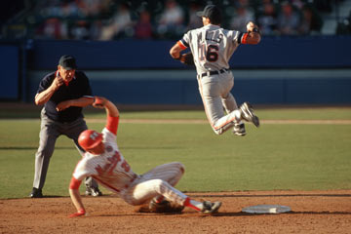
Let’s learn from videos
double play
Timecode 1:03

